Slide 1
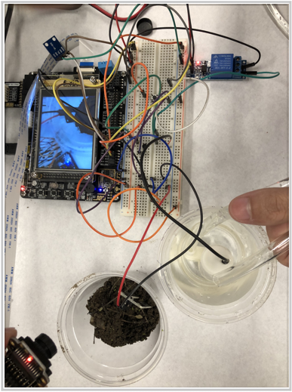
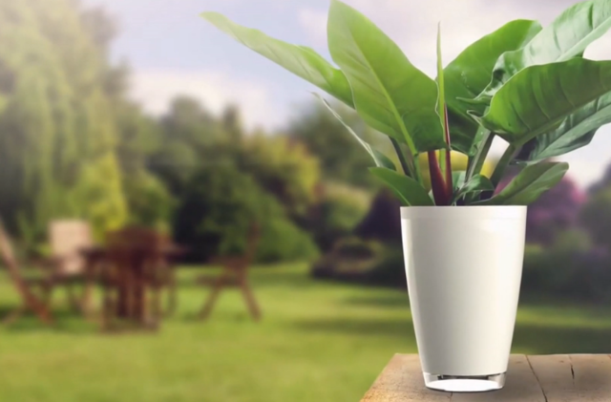
Intelligent Flower Pot
Group 11
Fu Xiao Han
Wong Hi HONG

Slide 2
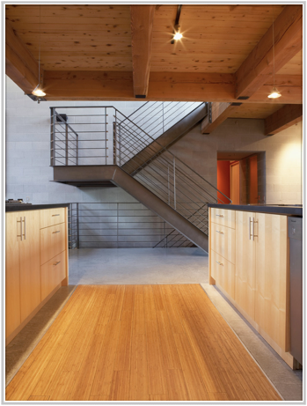
Background
Help people take care of their plants
Lacking attention to their plants in modern world
Many inexperienced and busy owner of plants

Slide 3
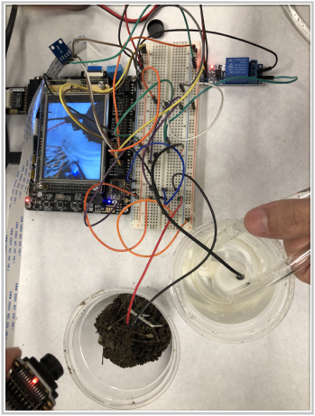
4 Major function
Show the parameter of the plants
Monitor the plants by camera
Automatically water plants
Communicate with phone through a web page

Slide 4
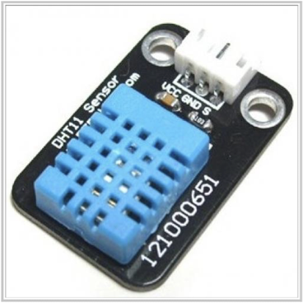
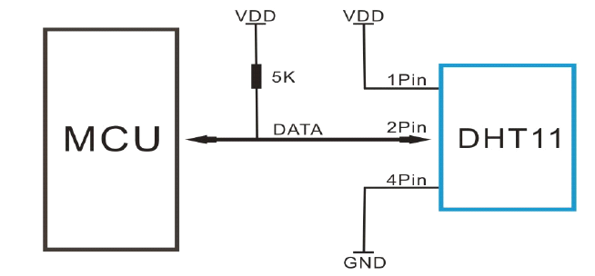
Sensors (DHT11)
Serial connect to STM32
GPIO (PE.6)
Digital output
detect air temperature and humidity

Slide 5
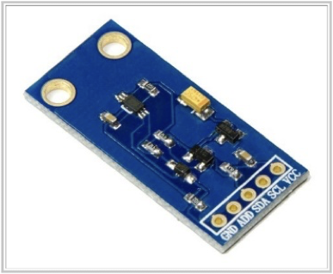
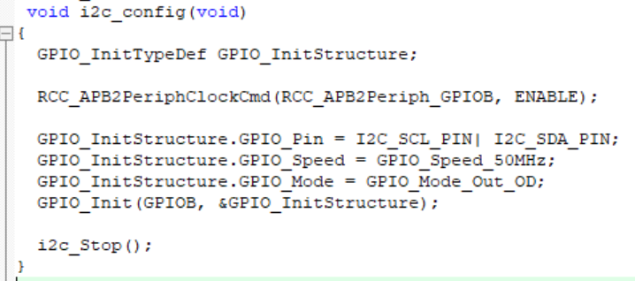
Sensors (BH1750)
Serial communication standard (I²C Bus)
PB.6 —>SCL
PB.7 —>SDA
Detect luminance

Slide 6
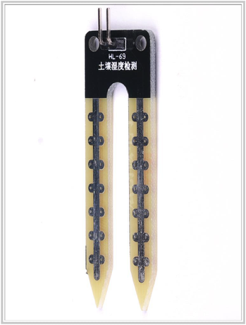
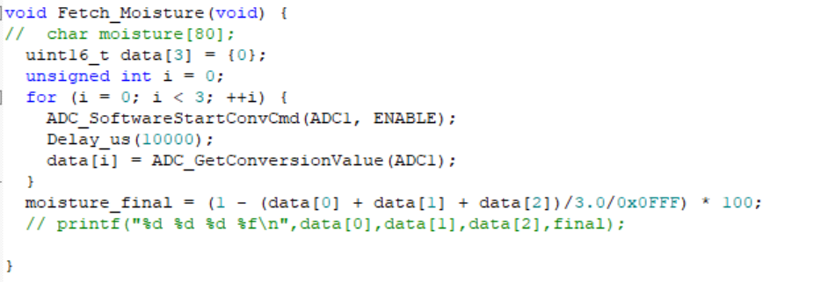
Soil Moisture Sensor
Analog-to-Digital Conversion (ADC)
PC.0
Get the converted digital data and reform it to percentage
Detect the soil moisture

Slide 7
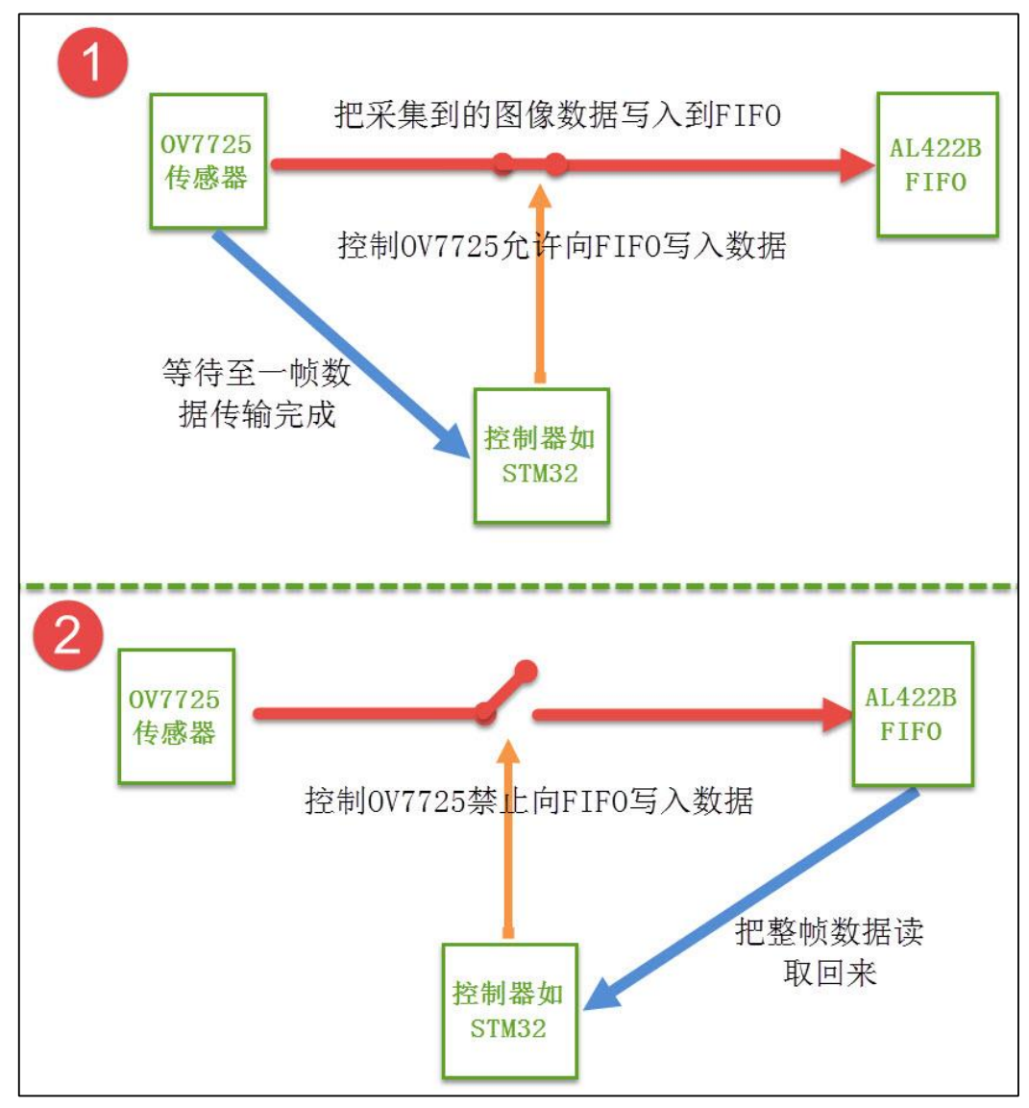
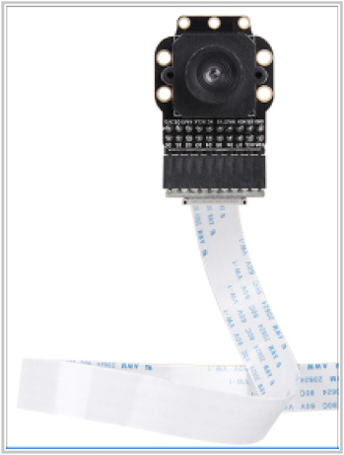
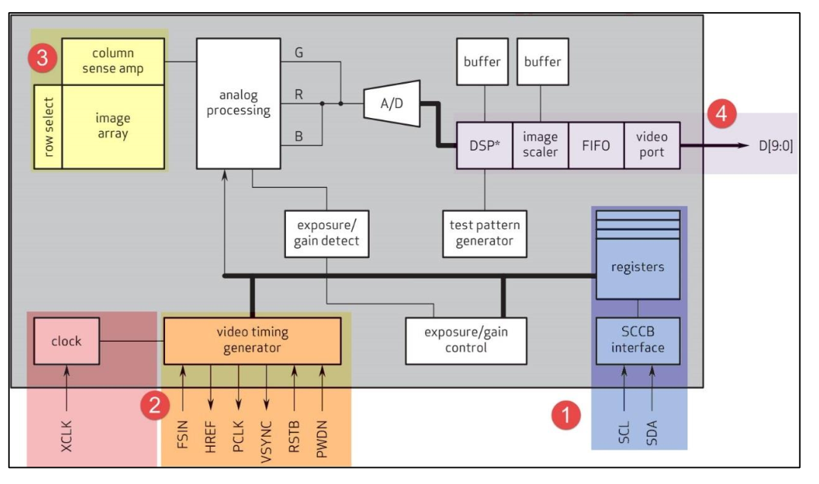
Camera (OV7725)
Connect to camera ports on stm32
Two mode
color and b/w mode
Can store photo on SD card

Slide 8
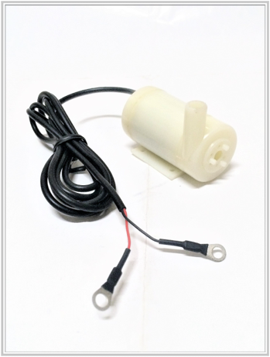
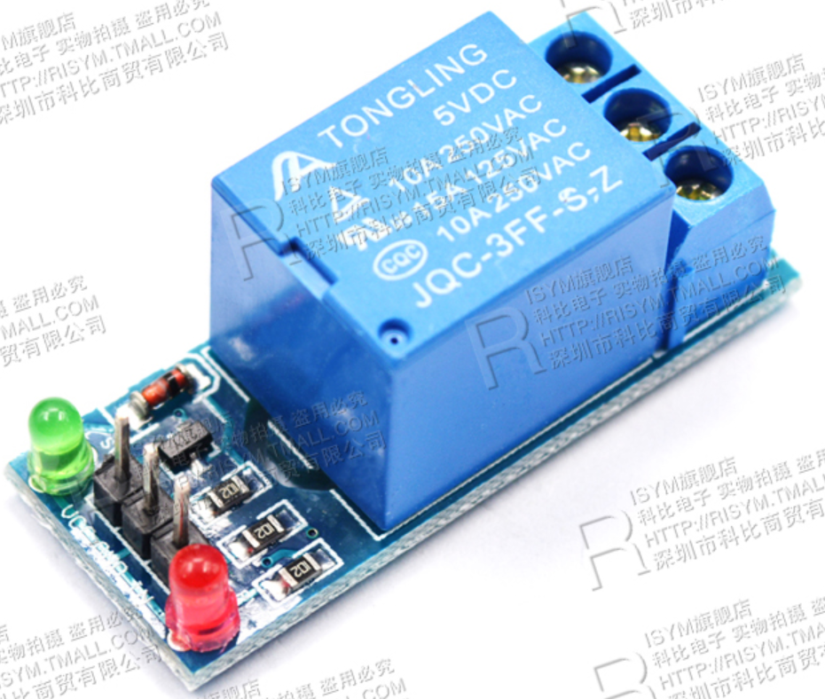
Water pump
5V DC to activate
GPIO connect to 5v electric relay to control the pump
PA.12 as the control signal for relay

Slide 9

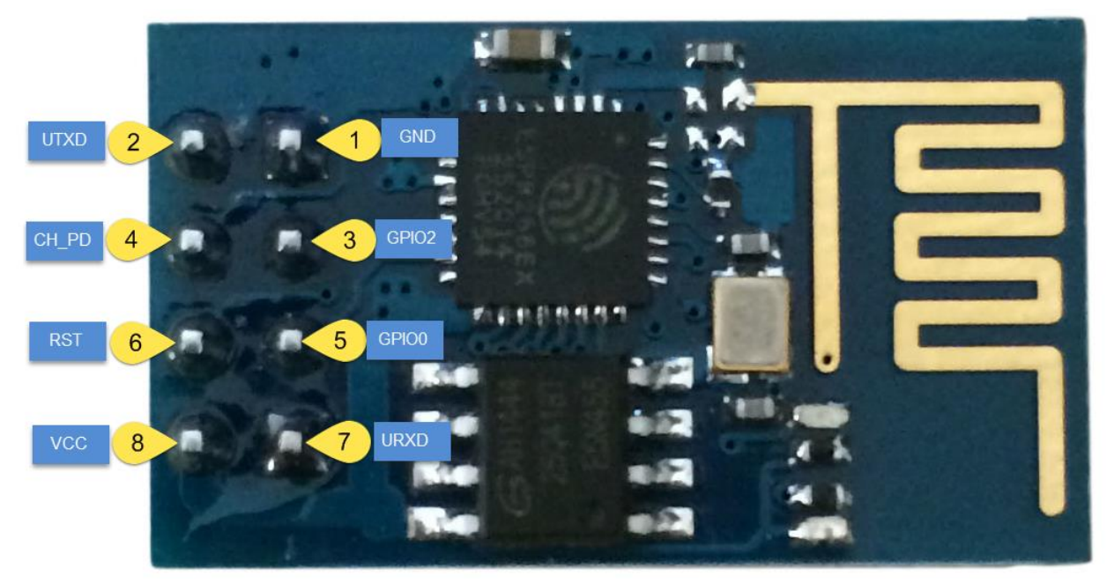
WiFi module
Connect to the Internet through ESP8266 Module
Communicate with remote server through TCP
Build a webpage
Real time update sensors’ data
Support remote observation and water controlling

Slide 10

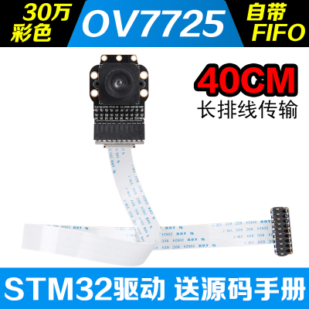

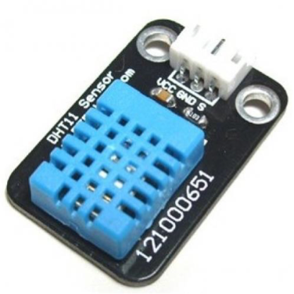
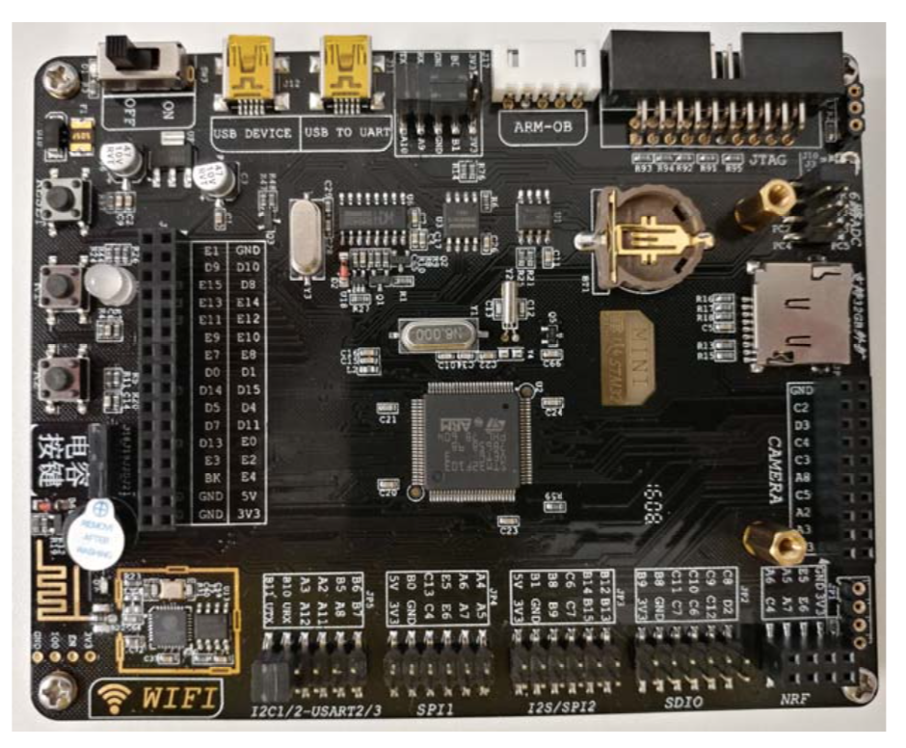

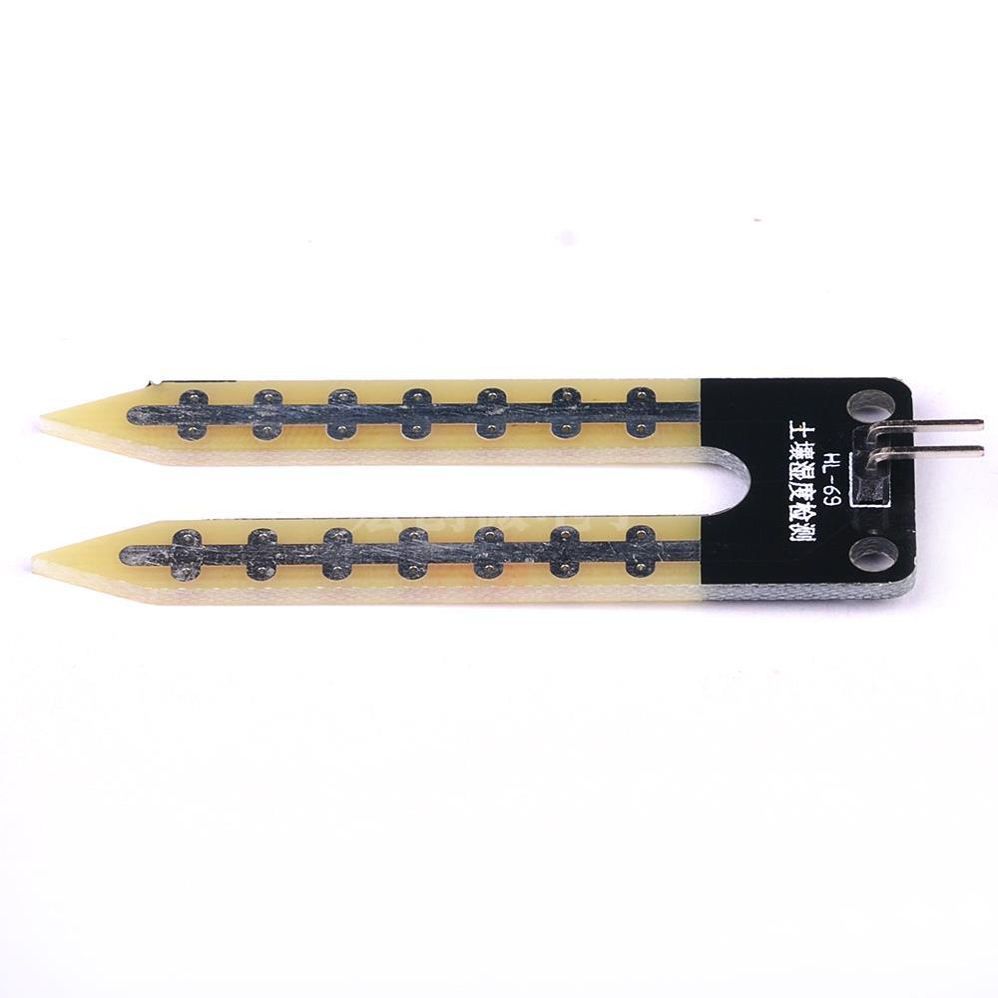

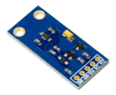
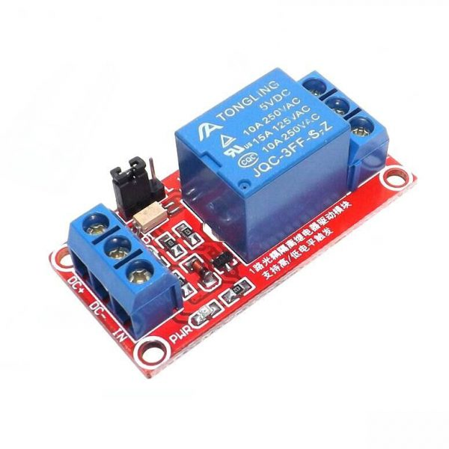

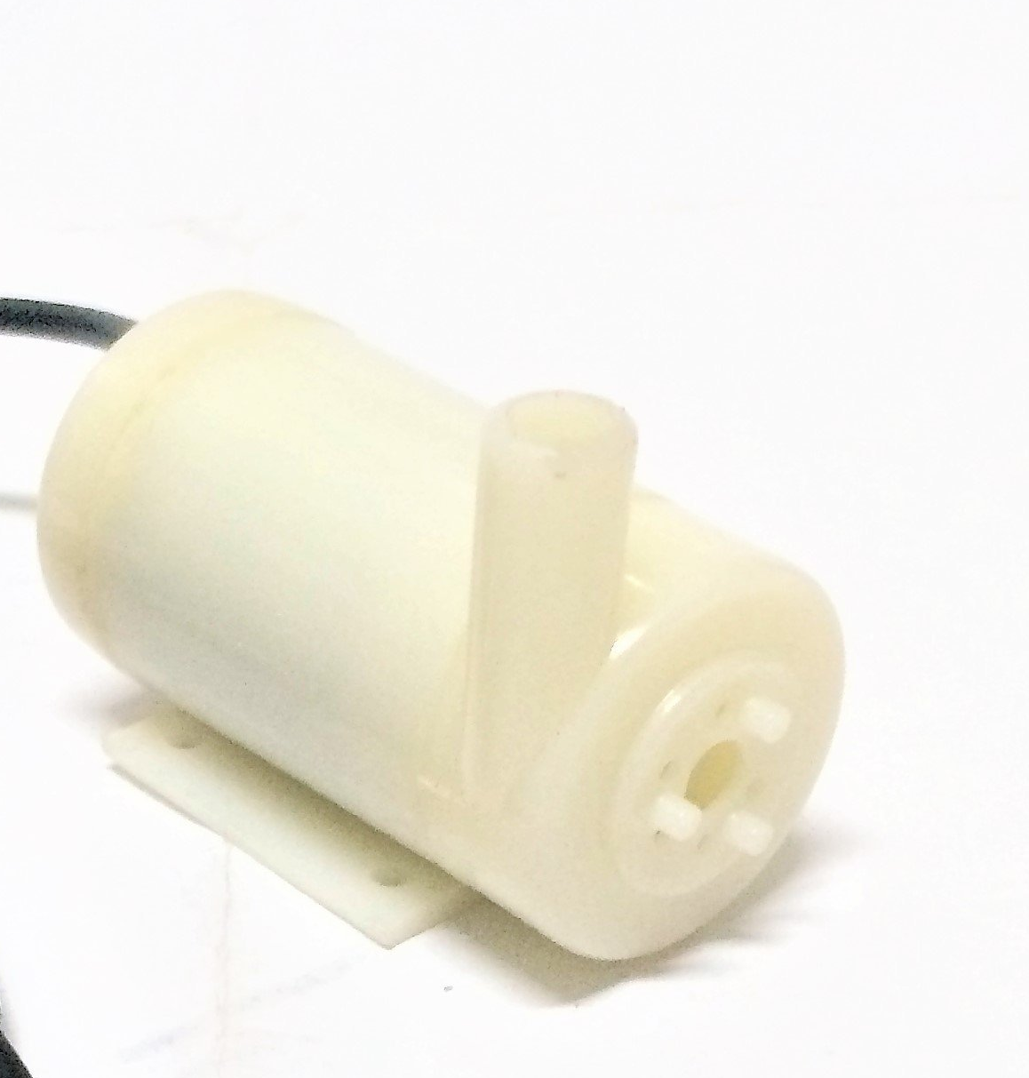



Design Diagram
Internet

Slide 11
Demonstration
Procedure
1: Choose the type of plants
2: Enter the monitor mode
3: Show the parameter of plants
4.Photograph the plant and store in SD card
5.Water the plant by button and phone
6. Automatically water plant
Color mode
B/W mode
Temperature
Humidity
Soil moisture
Luminance

Slide 12
Difficulties
Wifi module
Camera occupy many pins in the stm32 (conflict with internal ESP8266)
Limited performance restrict the I/O amount
Water pump
Need digital output to control
Use electronic relay
Mystery effect on Wifi Module when drived

Slide 13
Future improvement
Implant more plants information
Add soil fertility parameter (soil conductivity) and PH value

